Slide 1
202304深圳二模
推荐信
---推荐介绍中学生校园生活的视频拍摄内容

Slide 2
审题
假定你是李华，你校交换生Hans在策划“Approaching Chinese Students”栏目，用短视频介绍中学生校园生活，为此咨询你的意见。请你给他写一封邮件，内容包括：
1.推荐拍摄内容；
2. 陈述理由；
3. 表达祝愿。
文体：
推荐信
一般现在时
第/三人称
主要时态：
人称：
主要内容：
推荐内容与理由

Slide 3
Outline
背景：
你向交换生推荐短视频拍摄内容
Para. 1
要点1：表明写作背景+写作目的
Para. 2
要点2: 推荐内容及理由
要点3: 期待所荐有用
Para. 3
提炼信息列提纲
明确主次分段落

Slide 4
Here are some related phrases.
短语积累
make recommendations for… 推荐….
work on the program 致力于这个节目
campus life 校园生活
be devoted to doing … 致力于…
witness sb doing sth 目睹某人做…
be enthusiastic about … 对…有热情
to their hearts’ content 全身心地
be of much help to... 有益于...

Slide 5
推荐信：
开头句
(1)得知你将来中国游玩，我向你推荐几处名声
Learning that you are coming to visit China, I’d like to recommend several places of interest to you.
(2)很高兴得知我们图书馆准备买新书，我写信来给你一些提议。
Glad/Delighted/ Pleased to learn that our library is planning to buy new books, I am writing to offer my recommendations.

Slide 6
【主体】
介绍所推荐的物品或人，说明推荐原因
(1)我推荐这本书的原因是它强调好习惯的重要性。
The reason why I recommend this book is that it stresses the importance of good habits.
(2)我认为北京是一个不错的选择有这几个理由。
There are several reasons why I think Beijing is a great choice.
(3)我建议你晚上在帐篷中睡觉以便你可以亲近大自然。
I recommend that you sleep in a tent at night so that you can get close to nature.

Slide 7
结尾
表达愿望，希望对方接受其推荐
(1)如果您有任何问题，请联系我。
If you have any question, don’t hesitate to contact me.
(2)如果你能考虑我的建议，我会非常高兴。
I'll be more than happy if you can take my recommendations into consideration.

Slide 8
开门见山，简练切题！
优秀学生段首句
I’m glad to receive your letter asking for my recommendation for the filming content, my suggestions are as follows.
Hearing that you want to work on the program called Approaching Chinese Students, I’d like to make some recommendations.
Informed that you are working on a program called Approaching Chinese Students, I am glad to make some recommendations as follows.
明确主题，简要拓展！

Slide 9
Brainstorm
课内学习活动
中学生校园生活
课外活动
宿舍生活

Slide 10
Para 2：如何写推荐内容及原因?（如学习活动，课外活动等方面）
活动内容：
努力学习
认真读书
参加各种活动
结果：
篇幅简短，内容单薄，无法体现语言表达能力。
对策：
对要点进行合理拓展，使内容丰满，详略得当！遇到翻译难点，则转换表达方式！
※如果简单罗列：
Good good study, day day up
focus on reading
take part in different activities

Slide 11
优秀学生段中句
Para 2：如何写推荐内容及原因?（如学习活动，课外活动等方面）
(Learning activities) What impresses us most on campus is the students’ devotion to their study.
(Learning activities) Not only do they have passion for reading, but also they are actively involved in various debates.
(extra-curricular activities) Apart from the above activities on campus, you also can focus on the after-school activities,varying from interest groups to all kinds of clubs.
阐述要点，延伸细节

Slide 12
Para 2：如何写推荐内容及原因?
When it comes to the campus life of middle school students, the most important thing for students is learning activities. I suggest that you turn your lens to classrooms, where you can witness students burying themselves in books and having heated debates with their peers. we can feel their enthusiasm for study through these scenes. As for extra-curricular activities, festivals and after-school clubs are fantastic chances that you shouldn't miss. You can see teenagers playing to their hearts’ content, showing their talents and making friends through teamwork.
注意检查语法错误。
合理运用连接词。
恰当选词，注意变换句型。

Slide 13
优秀学生段尾句
Para 3：如何收尾? （表达祝愿希冀，回归主题）
In a word, with the help of my suggestions, you will make great progress in your program.
I would be glad if my recommendation could be of great help to you and wish you succeed in running this program.
根据文章内容，表达美好祝愿，简练收尾

Slide 14
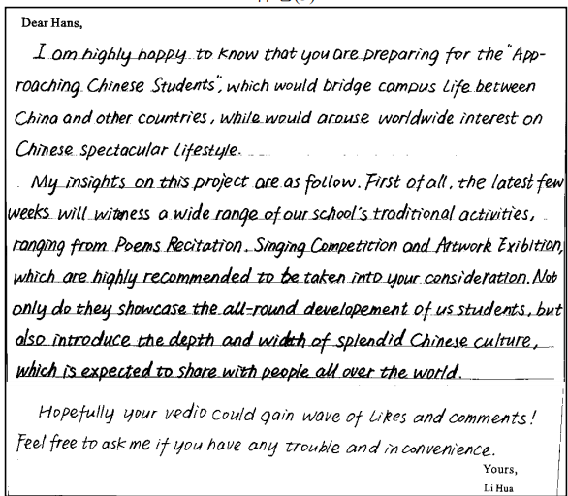
【得分】13~14【点评】文章结构完整，层次清晰，行文流畅。推荐理由陈述充分到位。使用了亮点句式，如定语从句、分词作定语、倒装句等，词汇丰富。首段和尾端均体现交际性

Slide 15
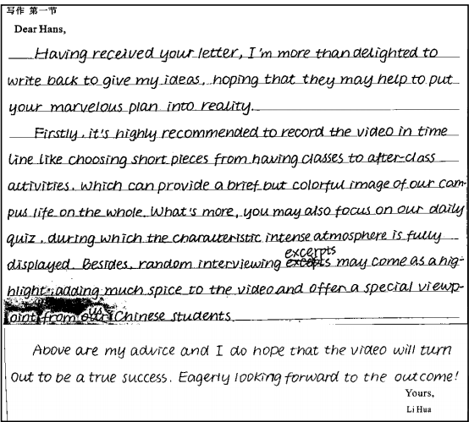
学生习作分析
【得分】14-15【点评】该考生审题严谨，第一段开头 Having received your letter，write back 说明写的是一封回信；第二段很好地回应了题目的要点 1 和 2，有实质的拍摄内容和推荐的理由，句式多变，有定语从句，形式主语，非谓语动词作状语，词汇丰富准确，语句连贯。整体卷面整洁，书写美观，详略得当，很好地发挥了邮件的交际功能。

Slide 16
优秀版范文
★
Dear Hans,
Previously informed that you are working on a program called Approaching Chinese Students. I feel honored to make some recommendations as follows.
When it comes to the campus life of middle school students, the most important thing for students is learning activities. I suggest that you turn your lens to classrooms, where you can witness students burying themselves in books and having heated debates with their peers. we can feel their enthusiasm for study through these scenes. Regarding extra-curricular activities, festivals and after-school clubs are fantastic chances that you shouldn't miss. You can see teenagers playing to their hearts’ content, showing their talents and making friends through teamwork.
I hope these suggestions will be helpful for you to create a successful channel and make it a window showcasing the colourful school life of Chinese students!
Yours,
Li Hua

Slide 17
优秀版范文默写
Previously informed that
1. _____________________you are working on a program called Approaching Chinese Students.
2. _____________to make some recommendations as follows.
3. _________________________________________________, the most important thing for students is learning activities.
4. I suggest that you turn your lens to classrooms, __________________ ________________________________________________________________we can feel their enthusiasm for study through these scenes.
5. _____________________________, festivals and after-school clubs are fantastic chances that you shouldn't miss.
6. I hope these suggestions ______________________________________
_________________________________________________________________
I feel honored
When it comes to the campus life of middle school students
where you can witness
students burying themselves in books and having heated debates with their peers
Regarding extra-curricular activities
will be helpful for you to create a successful channel
and make it a window showcasing the colourful school life of Chinese students.

